Slide 1
BUILDING MATERIALS AND CONCRETE TECHNOLOGY
B.Tech 2nd Year (IV Semester)
INTRODUCTION

Slide 2
SYLLABUS
UNIT 1 – BRICKS AND STONES, MASONRY
UNIT 2 – BUILDING COMPONENTS
UNIT 3 – OTHER CONSTRUCTION PRACTICES
UNIT 4 – CONSTITUENTS OF CONCRETE
UNIT 5 – FRESH CONCRETE

Slide 3
TEXT BOOKS
S.K. DUGGAL, “BUILDING MATERIALS”
S.C. RANGWALA, “ENGINEERING MATERIALS”
B.C. PUNMIA, “BUILDING CONSTRUCTION”

Slide 4
UNIT -1 CONTENTS
BRICKS AND STONES:
Properties of Building stones, Classification of stones.
Composition of good earth brick.
Qualities of a good brick,
Classification of bricks.
Manufacturing of clay bricks
Comparison between clamp burning and kiln burning.

Slide 5
CONTENTS Continued…
MASONRY
Definition and terms used in masonry
Brick masonry
Characteristics and requirements of good brick masonry
Bonds in brick work – Header, Stretcher, English, Flemish bon.
Stone masonry – Classification – random rubble, coursed rubble and Ashlar masonry.

Slide 6
BRICKS AND STONES:
STONES:
USES:
Construction of residential and public buildings.
Construction of dams, weirs, harbours, abutments for bridges, etc.
Facework of structures where massive appearance, solidity of construction and ornamental features are the primary requirements.
Used as road metal and railway ballast.
Used as aggregate for concrete.

Slide 7
CLASSIFICATION OF STONES
GEOLOGICAL
PHYSICAL
CHEMICAL
PRACTICAL

Slide 8
GEOLOGICAL CLASSIFICATION
IGNEOUS ROCKS
SEDIMENTARY ROCKS
METAMORPHIC ROCKS

Slide 9
IGNEOUS ROCKS
They are formed by cooling the molten lava on or inside the earth’s surface during the volcanic eruption.
The portion of lava, outside the surface, cools quickly and forms non – crystalline nature called Basalt.
The portion of lava, inside the surface, cools slowly and forms crystalline nature called Granite.

Slide 10
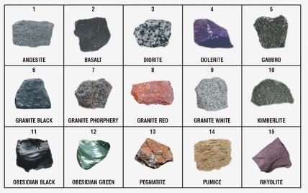
TYPES OF IGNEOUS ROCKS

Slide 11
SEDIMENTARY ROCKS
These rocks are formed by gradual deposition of disintegrated rocks, vegetable matter and clay at the bottom of the rivers, lakes or sea.
Examples:
Lime stone
Sand stone

Slide 12
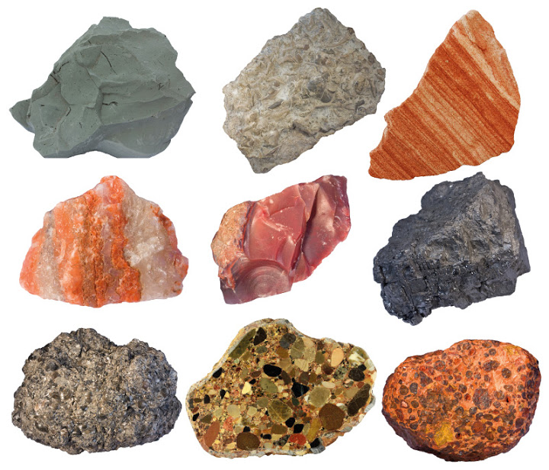
TYPES SEDIMENTARY ROCKS

Slide 13
METAMORPHIC ROCKS
When sedimentary or igneous rocks are subjected to great heat and pressure inside the earth, then a new variety of rock is formed which is known as metamorphic rocks.
Examples:
lime stone changes to marble.
slate changes to gneiss.

Slide 14
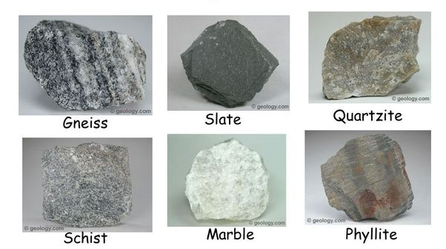
TYPES OF METAMORPHIC ROCKS

Slide 15
PHYSICAL CLASSIFICATION
Stratified rocks
Unstratified rocks

Slide 16
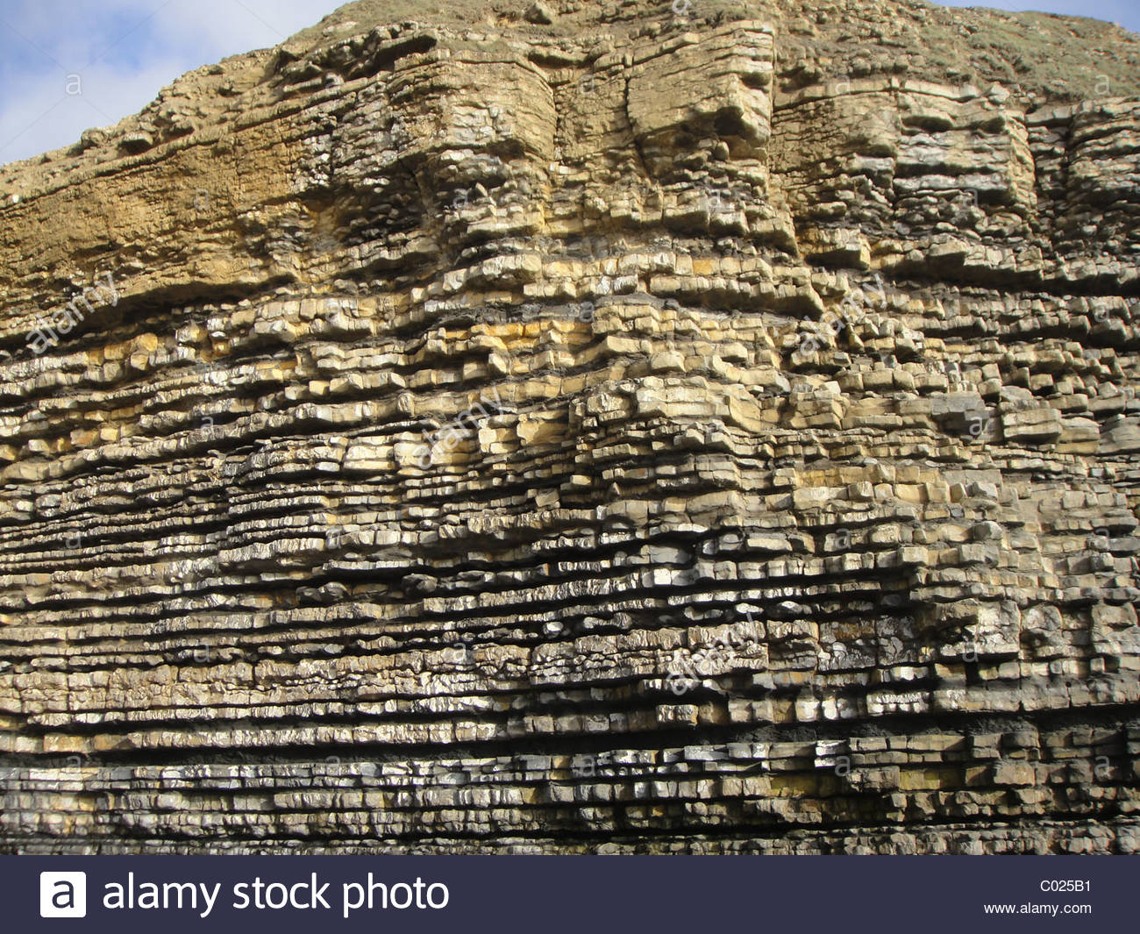
STRATIFIED ROCKS
Exhibit distinct layers which can be separated
Examples:
Lime stone
Slate
sandstone

Slide 17
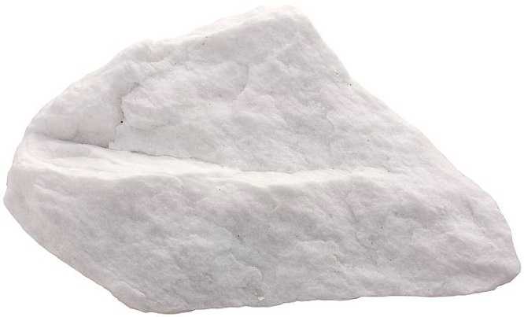
UNSTRATIFIED ROCKS
Do not show any sign of strata and cannot be easily split into slabs.
Examples:
Granite
marble

Slide 18
CHEMICAL CLASSIFICATION
SILICIOUS
ARGILLACEOUS
CALCARIOUS

Slide 19
SILICIOUS ROCK
Silica is the main constituent.
Rocks containing silica in free form are harder.
Examples
Sandstone
Quartzite

Slide 20
ARGILLACEOUS ROCKS
Clay or alumina is the main constituent.
Slate, laterite, kaolin, etc., belong to this category

Slide 21
Calcarious rocks
Calcium carbonate or lime are the leading constituent.
Examples:
Limestone
Marble

Slide 22
PROPERTIES OF GOOD BUILDING STONES
Appearance and colour
Weight
Porosity and absorption
Fineness of grain
Compactness
Resistance to fire
Hardness and toughness
Strength
durability
Dressing
Cost
seasoning

Slide 23
QUESTION
Explain the Geological Classification of stones?

Slide 24
BRICKS
Bricks are obtained by moulding clay in rectangular blocks of uniform size and the by drying and burning these blocks.

Slide 25
COMPARISON OF STONE AND BRICK
S.No | Stone | Brick
1 | It is heavier than brick | It is lighter than stone
2 | It is obtained from rocks | Made from clay
3 | Free from clay holes and flaws | Free from lumps, flaws and cracks
4 | Hard and tough | Hard and sound
5 | It absorbs heat more than a brick | It absorbs less heat comparatively
6 | Water absorption is less than 5% | Water absorption is less than 16%
7 | It is uniform in colour and can be shaped to desired size. | Uniform in colour, shape and size
8 | It has high durability which depends upon its chemical composition and its physical structure | Its durability is less than that of stone
9 | Particularly suitable for construction work in industrial area as it is acid and smoke proof. | Acid and smoke resistance is good but less than that of stone.
10 | Quarrying dressing and transportation costly. | Overall cost of manufacture less than stone.
11 | Labour cost for laying is high | Easily laid to form walls of required uniform thickness, labour cost for brick masonry much less.

Slide 26
COMPOSITION OF GOOD EARTH BRICK
Alumina: 20 – 30 %
Silica : 50% to 60%
Lime: <5%
Oxide of iron: 5 – 6%

Slide 27
MANUFACTURE OF BRICKS
Preparation of clay
Moulding of bricks
Drying of bricks
Burning of bricks

Slide 28
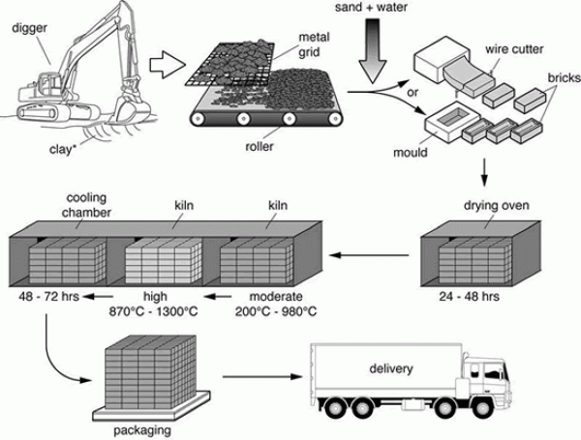
Process of brick manufacturing

Slide 29
Preparation of Clay
UNSOILING: Top layer of 20cm depth is removed as it contains impurities
Digging: clay dug out from ground is spread on level ground about 60 to 120cm heap.
Cleaning: stones, pebbles, vegetable matter etc, are removed and converted into powder form.
Weathering: clay is exposed to atmosphere from few weeks to full season.
Blending: clay is made loose and any ingredient to be added to it, is spread out at top and turning it up and down in vertical direction.
Tempering: clay is brought to a proper degree of hardness, then water is added to clay and whole mass is kneaded or presses under the feet of men or cattle. Tempering is usually done in a pug mill.

Slide 30
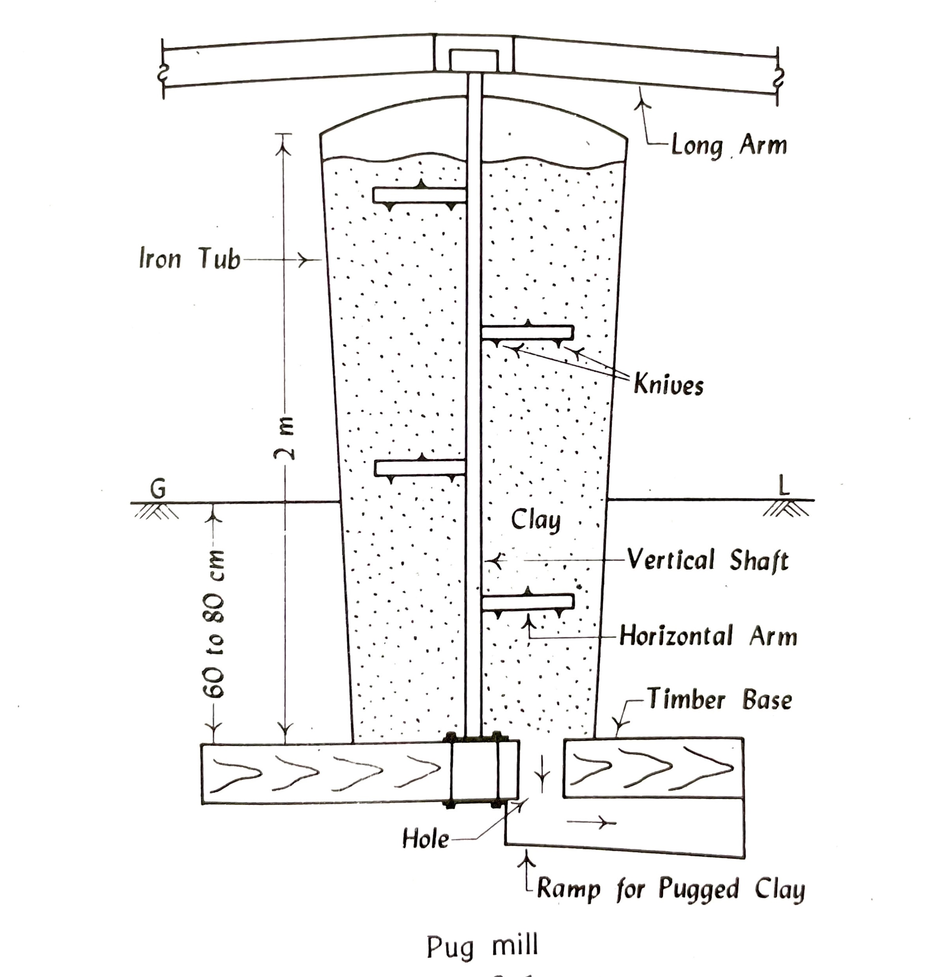
PUG MILL

Slide 31
MOULDING
HAND MOULDING
Ground moulded bricks
Table moulded bricks
MACHINE MOULDING
Plastic clay machines
Dry clay machines

Slide 32
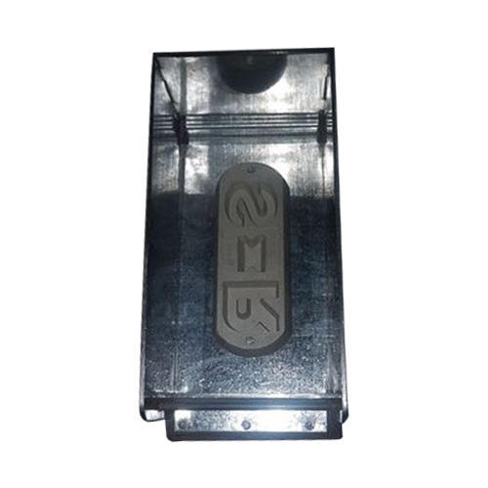
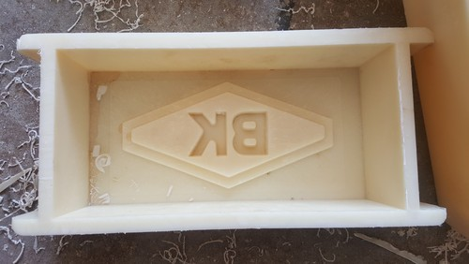
Hand mould
Moulds are rectangular boxes of wood or steel, which are open at top and bottom. Steel moulds are more durable and used for manufacturing bricks on large scale.

Slide 33
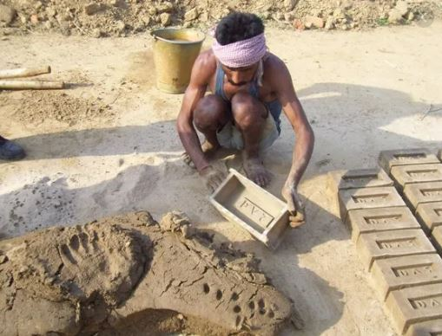
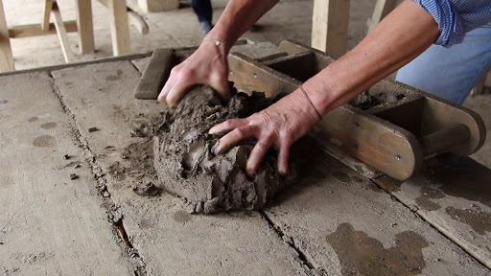
GROUND MOULDED BRICKS
TABLE MOULDED BRICKS

Slide 34
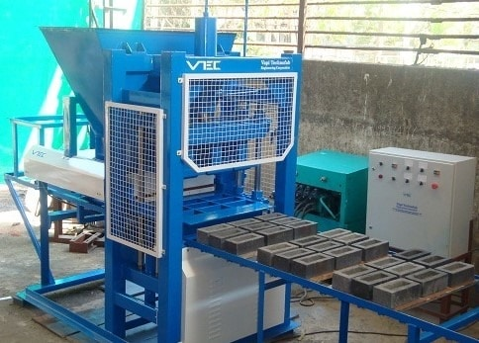
Machine moulding
This method proves to be economical when bricks in huge quantity are to be manufactured at the same spot. It is also helpful for moulding hard and sting clay.

Slide 35
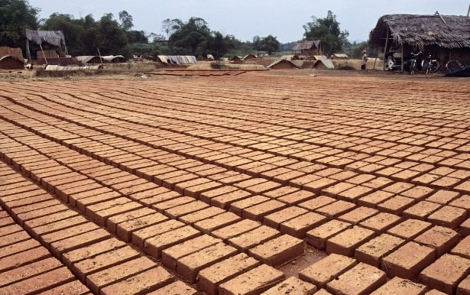
Drying
The damp bricks, if burnt, are likely to be cracked and distorted. Hence moulded bricks are dried before they are taken for the next operation of burning.
Natural drying
Artificial drying.

Slide 36
DRYING OF BRICKS
Natural drying
It is also called as hack drying. The wet bricks are arranged in rows on their edges on a slightly raised ground called hacks.
The air and sun dried bricks are adequately strong and durable and produce good results when employed for construction of simple structure.

Slide 37
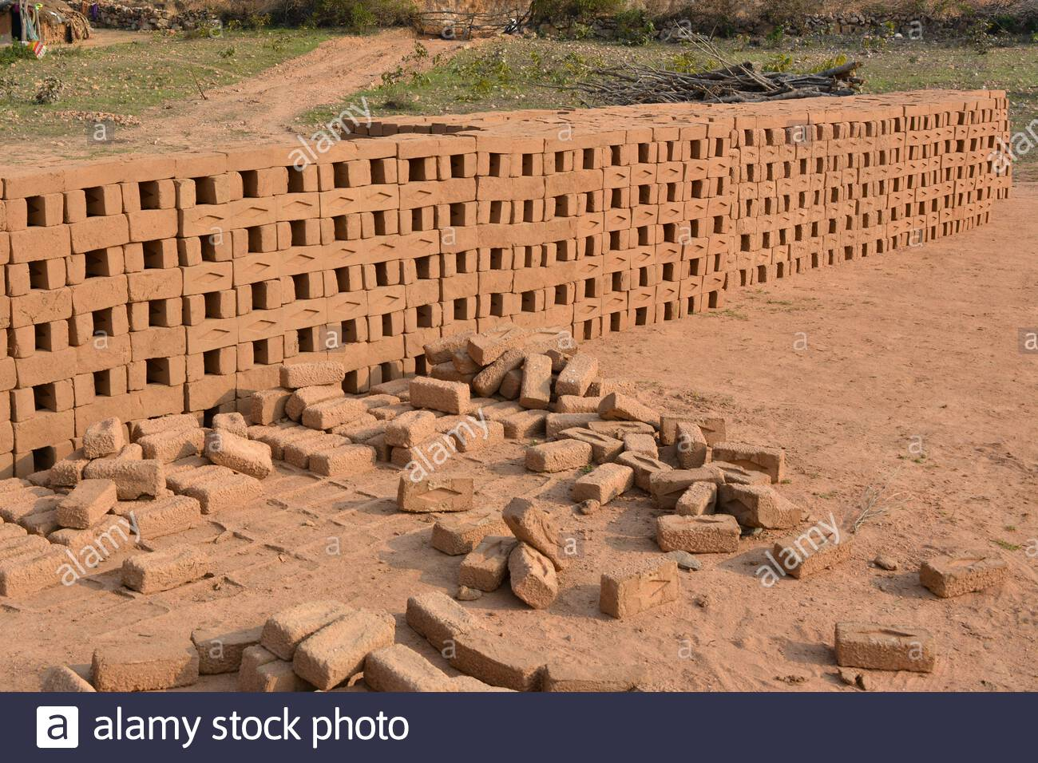
NATURAL BRICKS LAID ON HACKS FOR DRYING

Slide 38
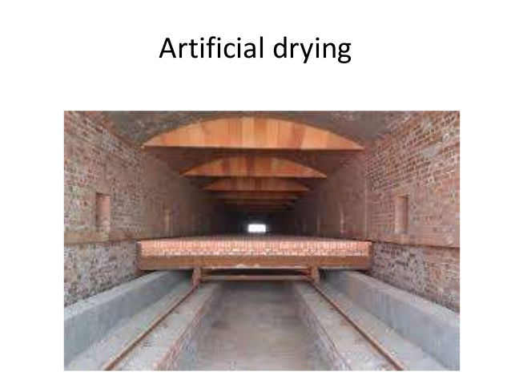
This method is used when bricks are required on a large scale and at a rapid rate.
The healing of the bricks is carried out in special driers such as a tunnels or chambers.

Slide 39
Burning
The purpose of burning bricks is to impart hardness, strength and makes them dense and durable.
Types of kilns:
Clamp or open kilns
Intermittent kilns
Continuous kilns

Slide 40
Clamp or open kilns
It is also known as pazawah.
It is suitable for burning only ordinary bricks, i.e. ground moulded bricks of inferior type.
The size of the clamp depends on number of bricks required. For one lakh brick its size should be 15m x 13m x 5m.
A slight slope of 15 degree is usually given to the ground lengthwise.

Slide 41
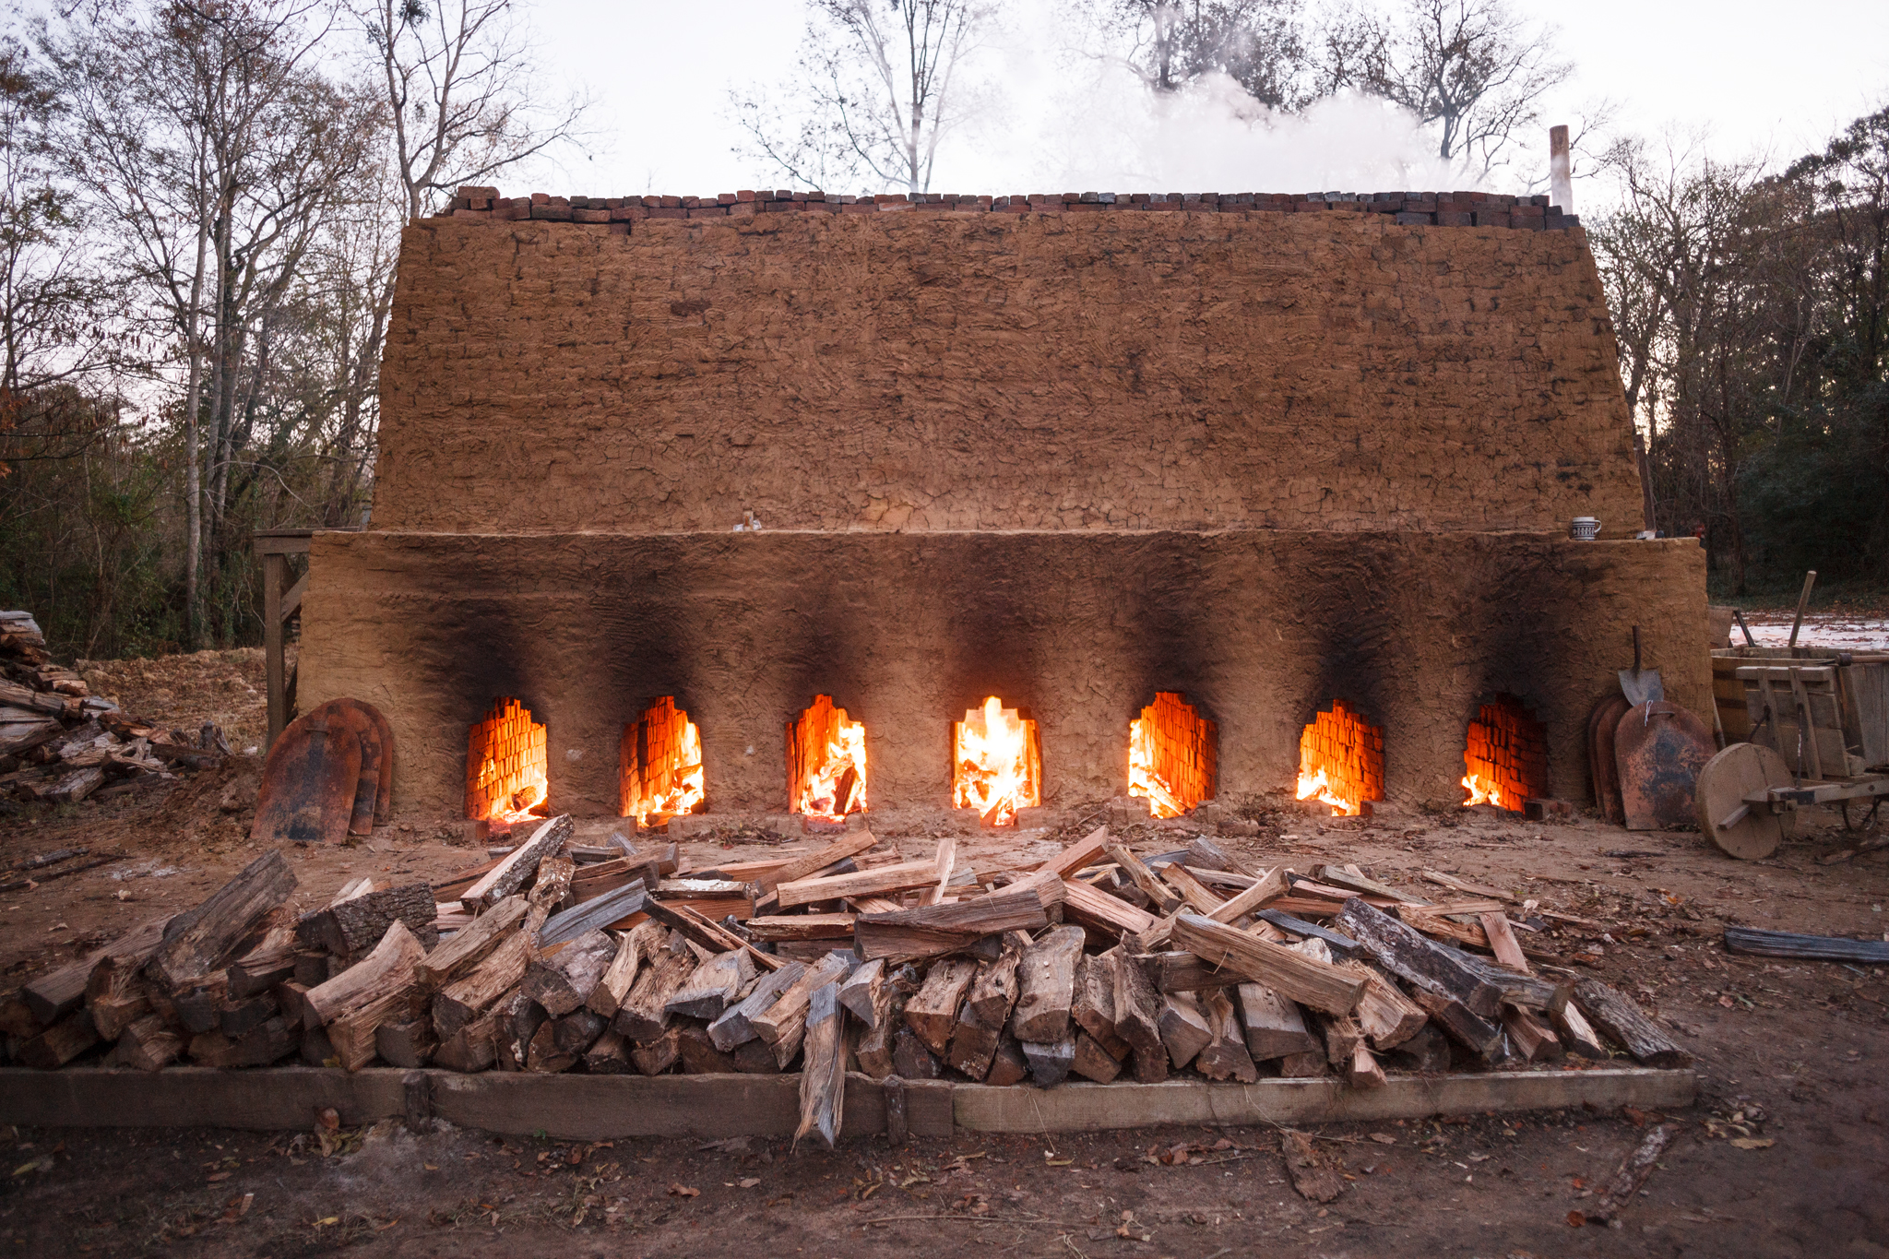
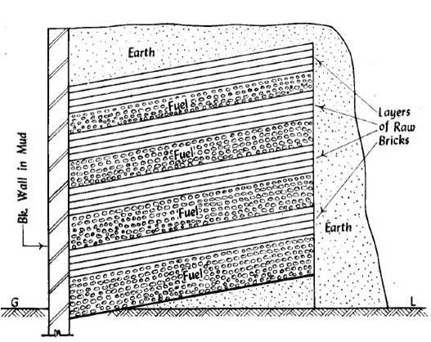

Slide 42
Clamp burning
Advantages:
Burning of bricks is cheap and economical.
Considerable saving of fuel.
Bricks produced are tough and strong
Skilled labour and supervision are not required for construction and making of clamps.
The clamp is not liable to injury from high wind or rain.

Slide 43
Clamp burning
Disadvantages
Very slow process.
The quality of brick is not uniform
The bricks are not regular shape.
The bricks are liable to burn unevenly.

Slide 44
Intermittent kilns
These kilns are permanent one as opposed to clamps which are temporary structures, and can be put to use again for building the bricks.
Here the burning is not continuous.

Slide 45
Continuous kilns
These are uninterrupted operation of building.
Bull’s trench kiln
Hoffman’s kiln
Tunnel kiln

Slide 46
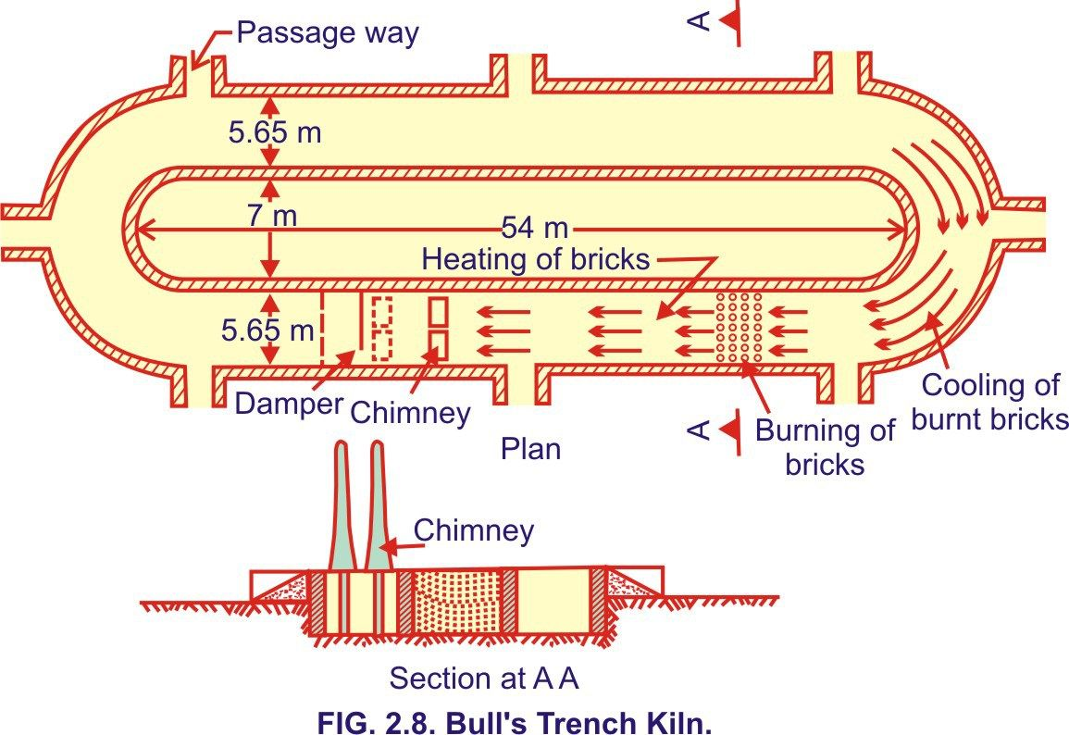
Bull’s trench kiln

Slide 47
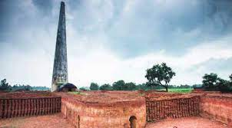
Advantages
Cost of fuel is less as heat of hot gases escaping the rough chimney is fully utilised for warming the bricks.
Supply of bricks is continuous.
High percentages of first class bricks.
As raw bricks are loaded in the kiln, the drying space is saved.
Disadvantages
High initial cost.
Constant skilled supervision is essential

Slide 48
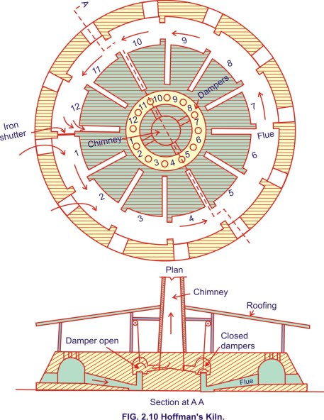
Hoffman’s kiln

Slide 49
Advantages:
High percentages of first class bricks.
Regular out turn of bricks
As the bricks can be loaded in the kiln, there is a saving in drying space.
Bricks are evenly burnt.
Economy in fuel since all the heat of combustion is utilised.
Disadvantages:
High initial cost of construction.
Constant and skilled supervision is required.
Economy demands regular consumption of its output, which may not be possible everywhere.

Slide 50

Comparison between clamp burning and kiln burning
S.No. | ASPECTS | CLAMP BURNING | KILN BURNING
1 | Initial cost | The initial cost is low | The initial cost is high.
2 | Fuel cost | Fuel cost is low, cow dung and litter can be used | Fuel cost is usually high as coal is used to burn the bricks.
3 | Structure | It is temporary structure | It is a permanent structure.
4 | Wastage of heat | A huge amount of heat is wasted from the top | No wastage of heat from sides or the top.
5 | Out-turn | It is used when small number of bricks are required. | It is employed when a continuous supply of bricks is required.
6 | Fire regulation | The fire once started cannot be regulated. | Fire can be regulated and even raw bricks can be burnt with safety.
7 | Labour | Once clamp is fired, no supervision is required. | Skilled supervision throughout the operation of the kiln is necessary.
8 | Time of burning and cooling | It takes 2 to 6 months to burn and cool the bricks. | Time of burning any section or compartment is 24 hours and time of cooling is 12 days.
9 | Percentage of first class bricks | On an average of 60% of bricks are of first class | Bricks are generally of good quality and 90% of them are of first class.
10 | Wastage of heat | Considerable wastage of heat. | Wastage of heat is least.

Slide 51
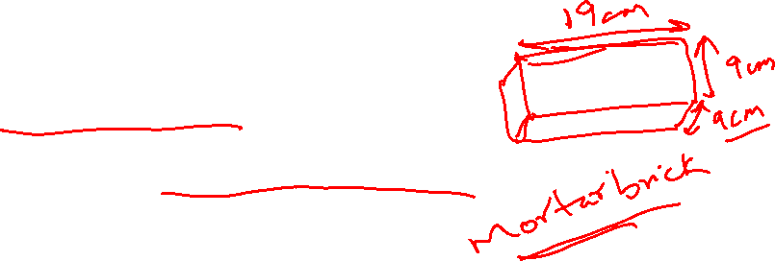
QUALITIES OF GOOD BRICK & TESTING OF BRICKS:
(IS 1077 and IS 3495)
1. DIMENSION TEST
The brick should have proper dimension along with sharp edges and colour of brick should be uniform & bright.
It should have following dimensions:
Standard size 19cm X 9cm X 9cm
Standard size with mortar 20cm X 10cm X 10cm

Slide 52
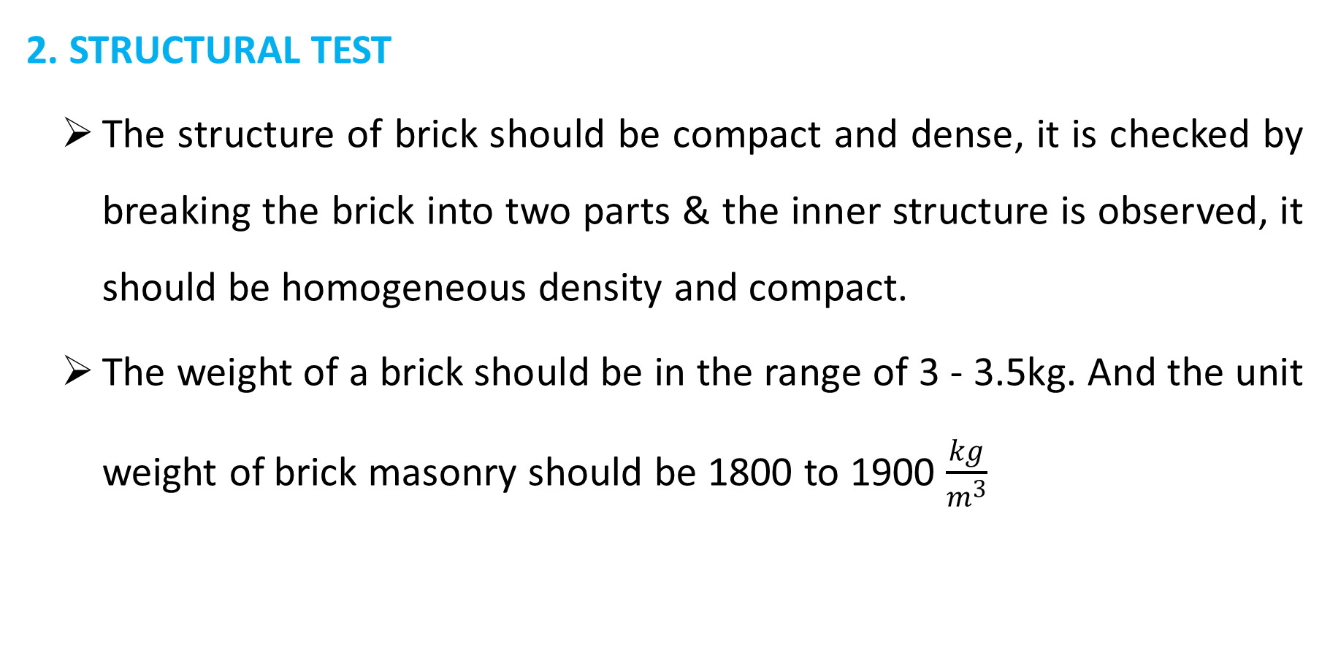
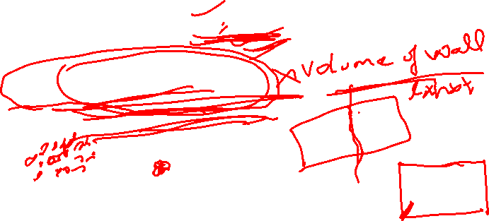
2. STRUCTURAL TEST
The structure of brick should be compact and dense, it is checked by breaking the brick into two parts & the inner structure is observed, it should be homogeneous density and compact.
The weight of a brick should be in the range of 3 - 3.5kg. And the unit weight of brick masonry should be 1800 to 1900 $\frac{kg}{m^{3}}$

Slide 53

3. STRENGTH TEST
To check the strength of brick gradual load is applied using CTM(Compressive Testing Machine) or UTM(Universal Testing Machine) up to the failure.
As per IS 1077 minimum strength of the brick should not less than 3.5MPa

Slide 54

4. WATER ABSORPTION TEST
To check the water absorption of brick, it is placed in water tank for 24hrs also.
Then the change weight of brick is expressed in percentage (%) with respect to initial dry weight. It is called as Percentage of Water Absorption.
It should not be more than permissible limit.

Slide 55

BRICK PER LIMIT
1ST CLASS 12-15%
2ND CLASS 16-20%
3RD CLASS 25%
The brick having strength more than 15MPa then limit is 15%.
Heavy duty brick – 5%
Fire brick – 10%

Slide 56
5. ALKALI TEST OR EFFLOURESENCE TEST
In this case brick is submerged in water for 24hrs, then the surface of brick should be free from any white patches, it is called as Efflorescence Test.
6. TOUGHNESS TEST
In this brick is drop on a hard surface from a height of 1m it should not break.

Slide 57
7. HARDNESS TEST
In this case scratching is done on the surface of brick with figure nail. Their should not be any sign of scratching on surface.
8. SOUNDNESS TEST
In this case two bricks are struck together then clear ringing metallic sound should be produce and brick should not break.

Slide 58
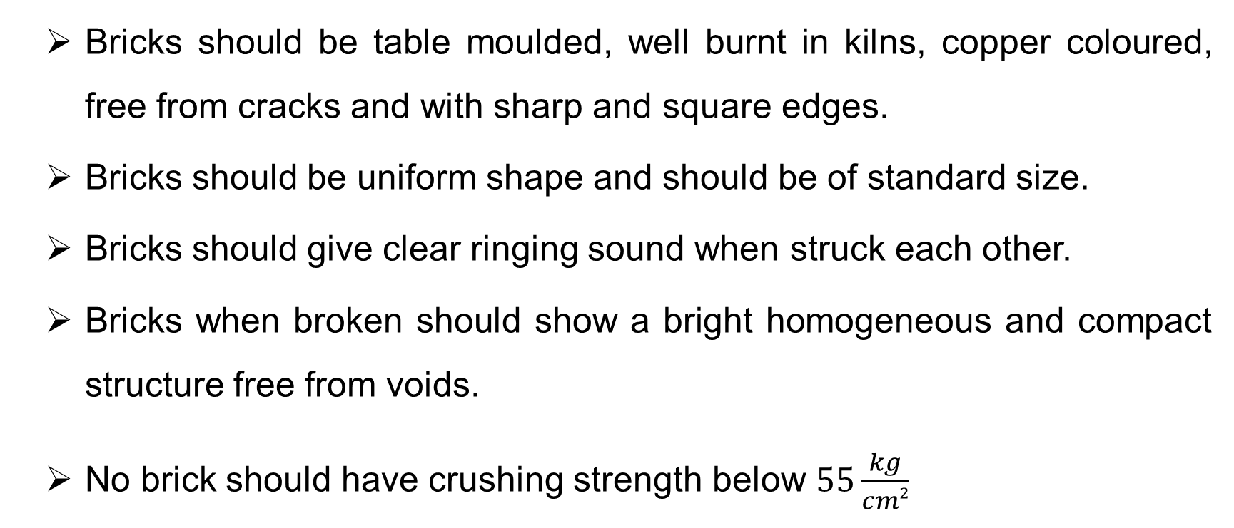
QUALITIES OF GOOD BRICK & TESTING OF BRICKS
Bricks should be table moulded, well burnt in kilns, copper coloured, free from cracks and with sharp and square edges.
Bricks should be uniform shape and should be of standard size.
Bricks should give clear ringing sound when struck each other.
Bricks when broken should show a bright homogeneous and compact structure free from voids.
No brick should have crushing strength below $55\frac{kg}{cm2}$

Slide 59
Bricks should not absorb water more than 20 percent by weight for first class bricks and 22 percent by weight for second class bricks, when soaked in cold water for a period of 24 hours.
Bricks should be sufficiently hard no impression, should be left on brick surface, when it is scratched with finger nail.
Bricks should be low thermal conductivity and they should be sound proof.
Bricks should not break when dropped flat on hard ground from a height of about one meter.
Bricks, when soaked in water for 24hours, should not show deposits of white salts when allowed to dry in shade

Slide 60
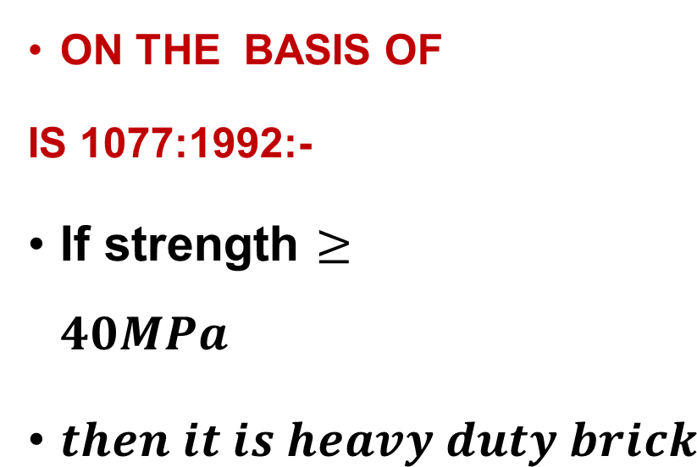

CLASSIFICATION OF BRICK:
CLASS DESIGNATION | AVG COMPRESSIVE STRENGTH NOT LESS THAN
 | $$N/mm^2$$ | $$Kg/cm^2 (approx.)$$
35 | 35 | 350
30 | 30 | 300
25 | 25 | 250
20 | 20 | 200
17.5 | 17.5 | 175
15 | 15 | 150
12.5 | 12.5 | 125
10 | 10 | 100
7.5 | 7.5 | 75
5 | 5 | 5
3.5 | 3.5 | 35
ON THE BASIS OF
IS 1077:1992:-
If strength $≥$ $40MPa$
$then it is heavy duty brick$

Slide 61
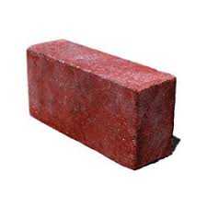

2. CONVENTIONAL CLASSIFICATION: (not as per IS code)
FIRST CLASS BRICK
These are thoroughly burnt and are of deep red, cherry or copper colour.
The surface should be smooth and rectangular, with parallel, sharp and straight edges and square corners.
These should be free from flaws, cracks and stones.
These should have uniform texture.
No impression should be left on the brick when a scratch is made by a finger nail.

Slide 62

The fractured surface of the brick should not show lumps of lime.
A metallic or ringing sound should come when two bricks are struck against each other.
Water absorption should be 12–15% of its dry weight when immersed in cold water for 24hrs.
The crushing strength of the brick should not be less than 10.5 N/mm² .
This limit varies with different Government organizations around the country. Uses: First class bricks are recommended for pointing, exposed face work in masonry structures, flooring and reinforced brick work.

Slide 63

SECOND CLASS BRICK
Second class bricks are supposed to have the same requirements as the first class ones except that
Small cracks and distortions are permitted.
A little higher water absorption of about 16–20% of its dry weight is allowed.
The crushing strength should not be less than 7.5 N/mm² .
Uses: Second class bricks are recommended for all important or unimportant hidden masonry works and centering of reinforced brick and reinforced cement concrete (RCC) structures.

Slide 64
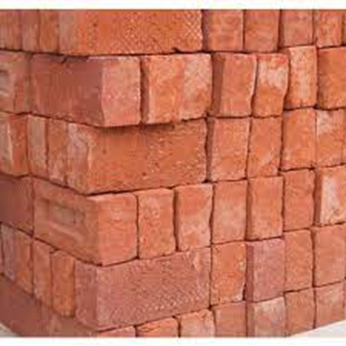
SECOND CLASS BRICK

Slide 65
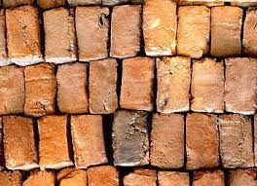

THIRD CLASS BRICKS
Third class bricks are under burnt.
They are soft and light-colored producing a dull sound when struck against each other.
Water absorption is about 25 per cent of dry weight.
The crushing strength of the brick should not be less than 3.5 N/mm²
Uses : It is used for building temporary structures

Slide 66
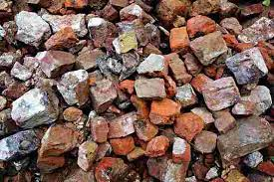

FOURTH CLASS BRICKS
Fourth class bricks are over burnt and badly distorted in shape and size and are brittle in nature.
Uses: The ballast of such bricks is used for foundation and floors in lime concrete and road metal

Slide 67
3. SPECIAL BRICKS:
Fire bricks / Refractory Brick's
This brick's arc manufactured using raw material fire clay which is a Special clay with high alumina content.
This bricks very much useful in Construction of refractory lining of chimney, kiln, furnace, fire boxes etc.,
Refractory bricks are further modified as
By increase silica content – acid brick can be obtained.
By increasing magnesia content – basic brick can be obtained.
By increasing alumina and chromium content – neutral bricks are obtained
By using chromium, iron ore and bauxite – chrome bricks can be obtained.

Slide 68
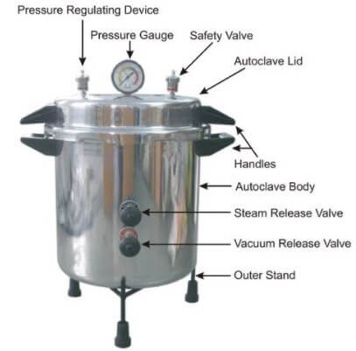
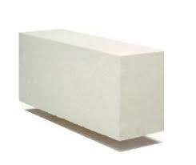
AUTOCLAVE BRICKS
It is a special brick which is manufactured in auto clave under high pressure.
This brick is light weight but sufficient strength.
It is very much useful in urban buildings for Partition walls to obtained better sound insulation, thermal resistance, and fire resistance etc.,

Slide 69
BRICK MASONRY
What Is Brick Masonry?
It is constructed by placing the bricks in the mortar in an orderly manner to produce solid mass, that can withstand excessive loads.
Brick is a building unit of hard inorganic clay material of size which can be conveniently handled.
The strength of brick masonry works depends upon the quality of bricks and type of mortar used.

Slide 70
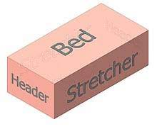
AS PER IS 2212
STRETCTER:
The longer face of the brick is called as stretcher.
HEADER:
The shorter face of brick is called as header.
CLOSER:
The portion obtained after cutting the brick along the length.
BAT:
The portion obtained after cutting the brick along the width.

Slide 71
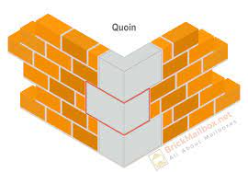
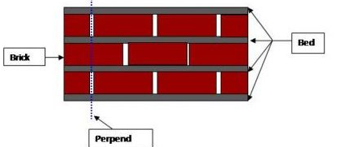
QUOIN:
Junction of two walls
Angle between the walls is called as quoin angle.
Generally 90º
PERPEND :
it is an imaginary line join in vertical joints in alternative layers

Slide 72
Note:
One brick thickness means- the thickness of wall is equal to length of brick(L)
Half brick thick: Thickness of wall = L/2.
One and Half brick thick: Thickness of wall = 3L/2.
Width of brick = L/2

Slide 73
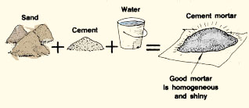
Mortar is the combination of
BINDING MATERIAL + FINE AGGREGATE + WATER

Slide 74
Generally mortars are following types used for brick masonry
(I) Mud mortar
(ii) Cement mortar
(iii) Cement lime mortar
(iv) Lime surkhe mortar

Slide 75
GENERAL PRINCIPLES IN BRICK MASONRY CONSTRUCTION:
1. A good brick masonry should utilize bricks, which are sound, hard, well burnt and tough with uniform colour, shape and size.
2. The bricks should be compact, homogeneous, free form holes, cracks, flaws, air-bubbles and stone lumps and soaked in water for at least two hours before use.
3. In the brickwork, the bricks should be laid on their beds with the frogs pointing upwards.

Slide 76
4. The brick courses should be laid truly horizontal and should have truly vertical joints
5. As far as possible the use of brick – bats should be discouraged
6. As far as possible the brick wall should be raised uniformly less than 1.5m in day with proper bond.
7. When the mortar is green the face joints should be racked to a depth of 12 to 19mm in order to have a proper key for plastering or pointing.

Slide 77
8. In order to ensure continuous bond between the old and the new, the wall should be stopped with a toothed end.
9. Finished brickwork should be cured for a period of 2 to 3 weeks for lime mortar and 1 to 2 weeks for cement mortar
10. In order to carryout the brickwork at higher level, a single scaffolding is used.

Slide 78
CHARACTERISTICS OF BRICK BOND OR RULES FOR BONDING:
1. The brick masonry should have bricks of uniform shape and size.
2. For satisfactory bondage the lap should be one-fourth of the brick along the length of the wall and half brick across thickness of the wall
3. The brick bats use should be discouraged
4. The vertical joints in the alternate courses should coincides with the center line of the stretcher

Slide 79
5. The alternate courses the center line of header should coincide with the center line of stretcher, in course below or above it.
6. The stretcher should be used only in the facing while hearting should be done in the headers only

Slide 80
BONDS IN BRICK MASONARY:
Bonds are provided for better arrangement of brick so that sufficient and decorative effect should be their.

Slide 81
CLASSIFICATIONS OF BONDS:
The bonds can be classified as follows:
(i) Stretcher bond
(ii) Header bond
(iii) English bond
(iv)Double Flemish bond
(v) Single Flemish bond
(vi) Garden wall bond
(vii) Facing bond
(viii) Dutch bond
(ix) Raking bond
(x) Zigzag bond
(xi) English cross bond
(xii) Bonds in columns
(xiii) Brick on edge bond or soldier course
(xiv) Bonds at junction and squint junction

Slide 82
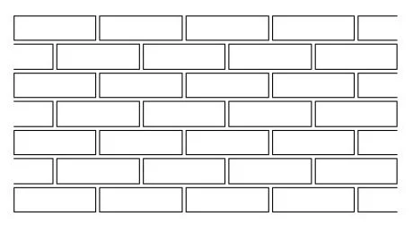
1. STRETCHER BOND:
All the bricks are stricter.
Minimum thickness is L/2.
It is suitable for long walls, partion, boundary walls etc.,
Minimum overlap L/2
In this type of bonding every course will be stretcher course.
To break the alignment of vertical joint. Half Bat can be provided in adjacent layer.

Slide 83
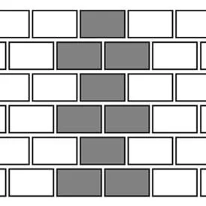
2. HEADER BOND:
In this type of bonding every course will be header course.
To break the alignment of vertical joints in adjacent course ¾ Bat is provided two in number in the end.
Overlap will be of L/4 brick.
Thickness minimum is 1brick thickness(L).
This type of bonding is mainly used in brick work foundation to transfer heavy load.

Slide 84
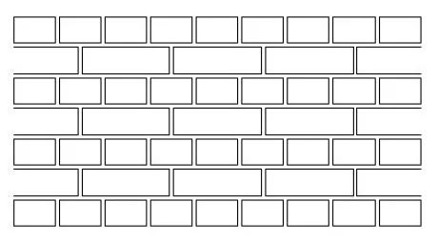
3. ENGLISH BOND:
In this type of bonding combination of header and strecter course will be their.
To break the alignment of vertical joints in adjacent layers Queen closer is provided after Quoin header.
Minimum thickness is required 1 brick (L).
It is strongest type of bonding.
Widely used in construction.
Mostly used bond in India.

Slide 85
FLEMISH BOND:
In this type of bonding in same course header & stretcher will be available on the face.
To break the alignment of vertical joint queen closer is provided after Quoin header.
Minimum thickness is 1 brick thickness.
Overlap is l/4 brick.
It is decorative in nature, that’s why it is generally provided on face.

Slide 86
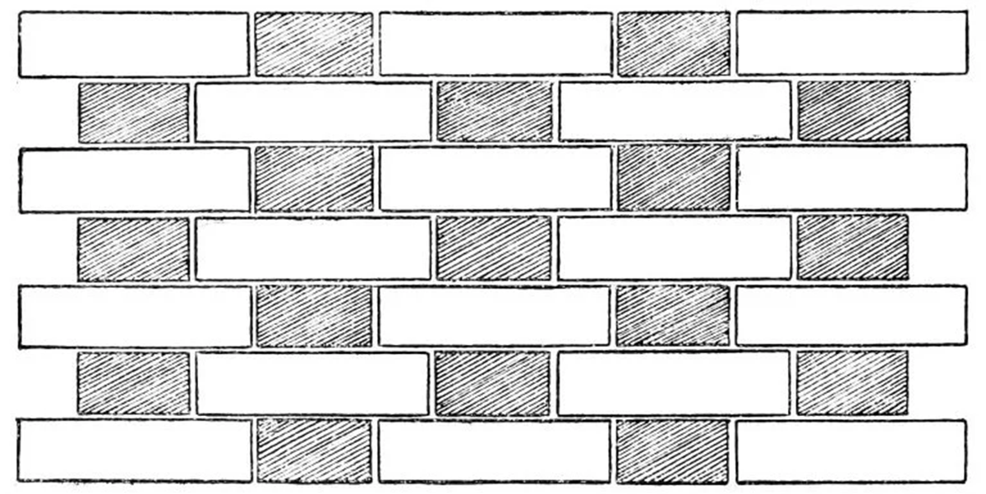
Hence if Flemish bond provided on the back English bond is their then it is called as single Flemish bonding.
Both faces Flemish bond is their then it is called as Double Flemish.
To make this bond skilled labour is required.

